Slide 1
Learn Variables in Python
Explained for Beginners
What is Variable?
Let’s do some practice using python!
Sajjad Mustafa

Slide 2
Variable
Variable

Slide 3
Uppercase and lowercase letters (A-Z, a-z)
Digits (0-9)
Underscore character (_)
Variable name can not start with digit
Can not use any Reserved Words
Name

Slide 4
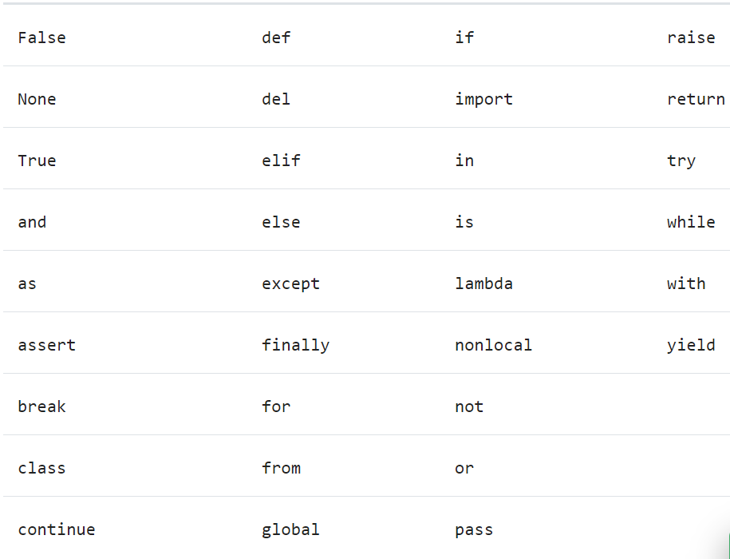
Reserved
Words

Slide 5
Website : www.aisciences.io

